Slide 1
5
Hypothesis Tests with Means of Samples

Slide 2
The Distribution of Means -1
Comparison distributions considered so far were distributions of individual scores
Now using hypothesis tests involving means of groups of scores, so comparison distribution will be distribution of means

Slide 3
The Distribution of Means -2
Theoretically, distributions of means are based on a very large number of samples of the same size (with each sample randomly drawn from the same population of individuals)

Slide 4
The Distribution of Means
How to make:
  Hard way – collect lots of samples and determine the mean from each sample
  Easy way – find the characteristics of the population of individuals and find the number of scores in each sample

Slide 5
The Distribution of Means
M and M demo!

Slide 6

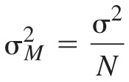
The Distribution of Means -3
Characteristics
  Its mean is the same as the mean of the population of individuals
  Its variance is the variance of the population divided by the number of individuals in each of the samples

Slide 7
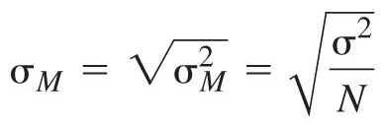
The Distribution of Means -4
Characteristics
  Its standard deviation is the square root of its variance

Slide 8
The Distribution of Means -4
Characteristics
  Shape: it is approximately normal if either
    Each sample includes 30 or more individuals
    OR
    The distribution of the population of individuals is normal

Slide 9
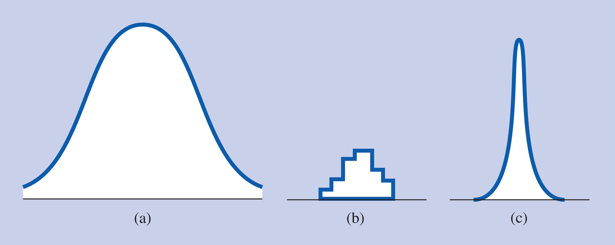
Review of the Different Kinds of Distributions
Distribution of a population of individuals
Distribution of a particular sample
Distribution of means

Slide 10
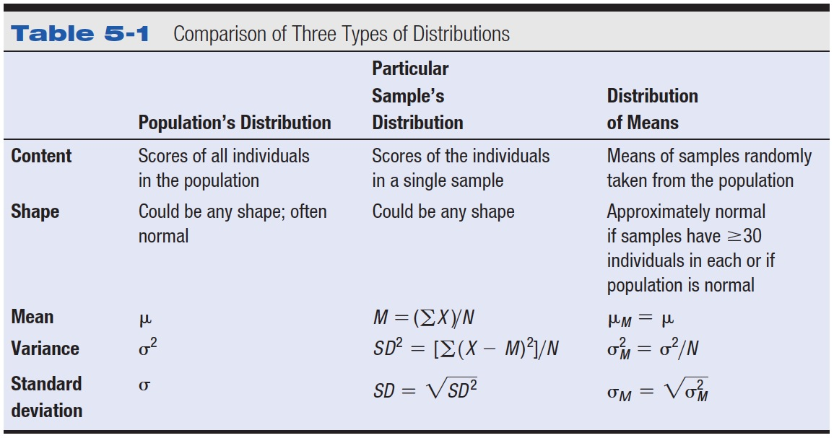
Table 5-1 Comparison of Three Types of Distributions

Slide 11
Testing
Now how do we test if our M and M’s match what Mars says they should be?

Slide 12
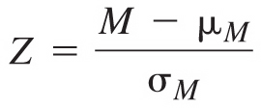
Z-tests
Hypothesis testing procedure in which there is a single sample and the population variance is known

Slide 13
Z-tests
How to do a Z-test
  Null/Res hypothesis
  Determine characteristics of comparison distribution
    Population mean, Population of means standard deviation

Slide 14
Z-Tests
How to do a Z-test
  3. Determine the cutoff sample score
  4. Figure out the Z-score
  5. Decide if you should reject

Slide 15
Estimation, Standard Errors, and Confidence Intervals
Confidence interval – roughly speaking, the range of scores that is likely to include the true population mean
Confidence limit – upper or lower value of a CI
Copyright © 2009 Pearson Education, Inc. Upper Saddle River, NJ 07458. All rights reserved.

Slide 16
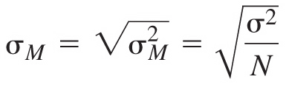
Estimation, Standard Errors, and Confidence Intervals -2
Steps for figuring confidence limits
  Figure the standard error
  Figure the raw scores for 1.96 standard errors (95% confidence interval) or 2.58 standard errors (99% confidence interval) above and below the sample mean

Slide 17
Controversies and Limitations
Confidence intervals or significance tests?
  Confidence intervals
    Give additional information
    Focus attention on estimation
    Less likely to be misused by researchers
  Significance tests
    Necessary for some advanced statistical procedures

Slide 18
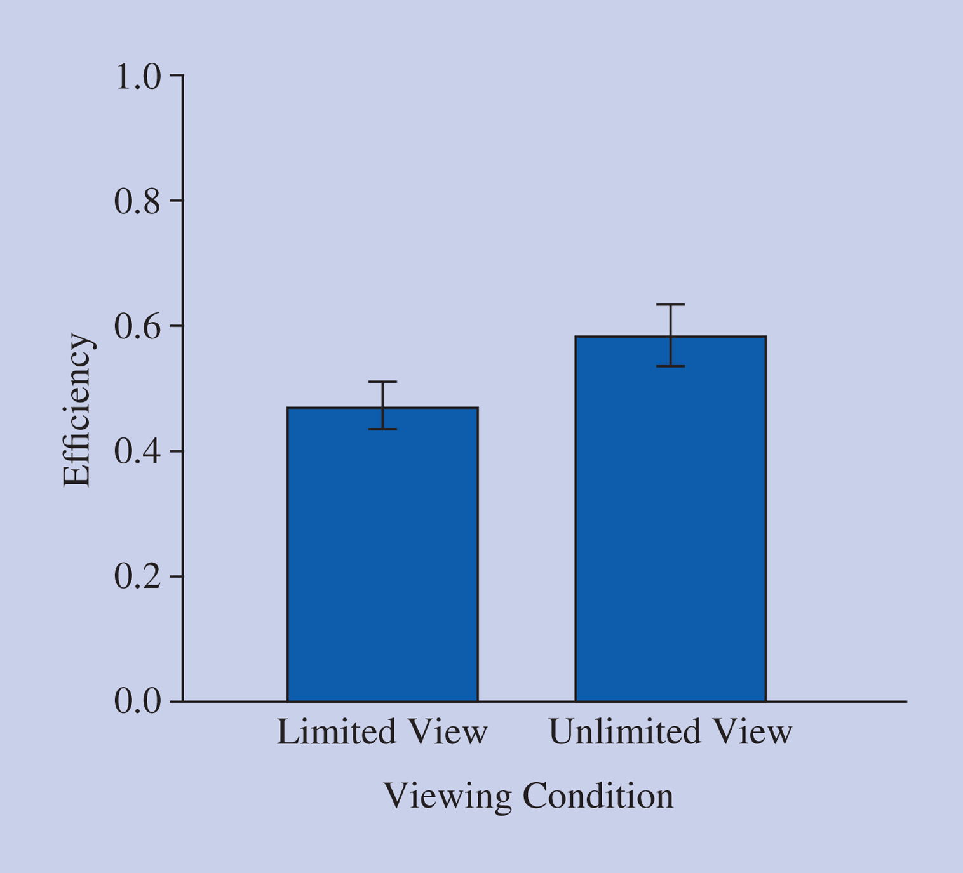
Reporting in Research Articles
Z test
Standard error, SE, SEM
  Standard error bars

Slide 19
Examples
A social psychologist interested in relationships has developed a scale that measures the degree of affection adult men feel for their fathers. The distribution for the general population is skewed to the right, the mean degree of affection is 60, and the standard deviation is 16. Wondering if men who have themselves just become new fathers will score higher on the scale than men in general, the psychologist samples a group of 100 new fathers and finds that their mean affection score is 64.5.

Slide 20
Examples
A large school district is considering implementing a program that, if successful, would improve the reading scores of its students by 10 points. The current reading scores for the district are normally distributed with a mean of 37 and a standard deviation of 12. The administrators decide to test the new program in one school of 340 students.

Slide 21
Examples
A private school promoted itself by advertising that its graduates had an average SAT verbal score of 550 with a standard deviation of 100. At the end of the school year, the Parent-Teacher Association (PTA) decided to see if the SAT scores for students at the school were different from the advertised average and found that the average SAT verbal score for 80 graduating seniors was 532. Using the .05 significance level, what should the PTA conclude about the school's claim?
a. Use the five steps of hypothesis testing.

